Slide 1
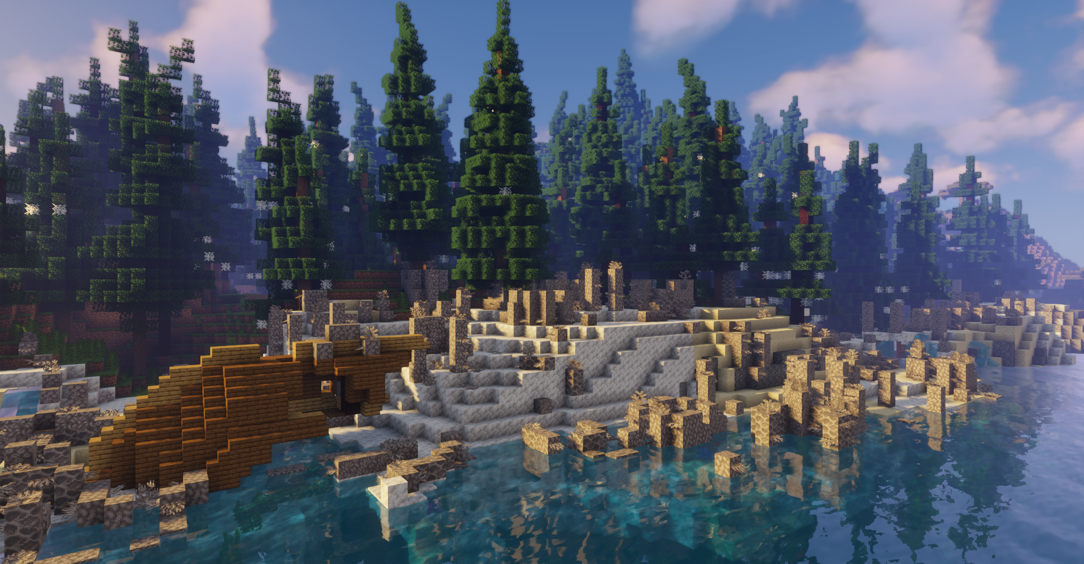


Slide 2
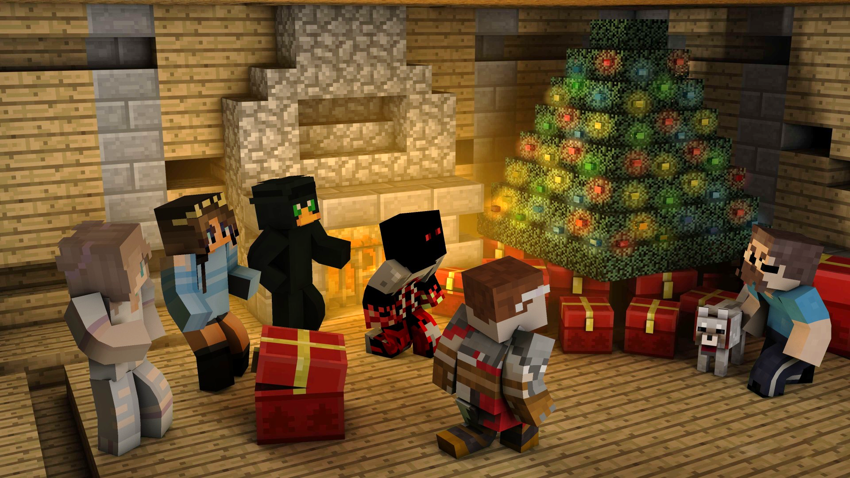



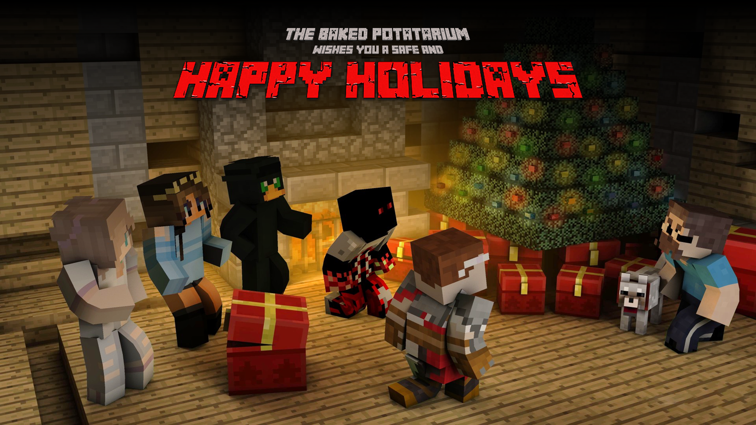

Slide 3




Slide 4
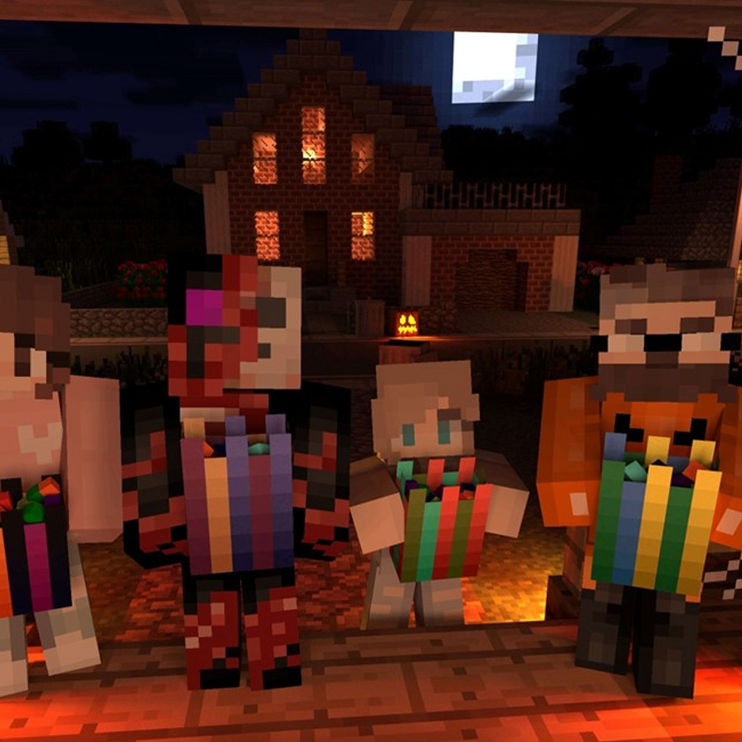


Slide 5
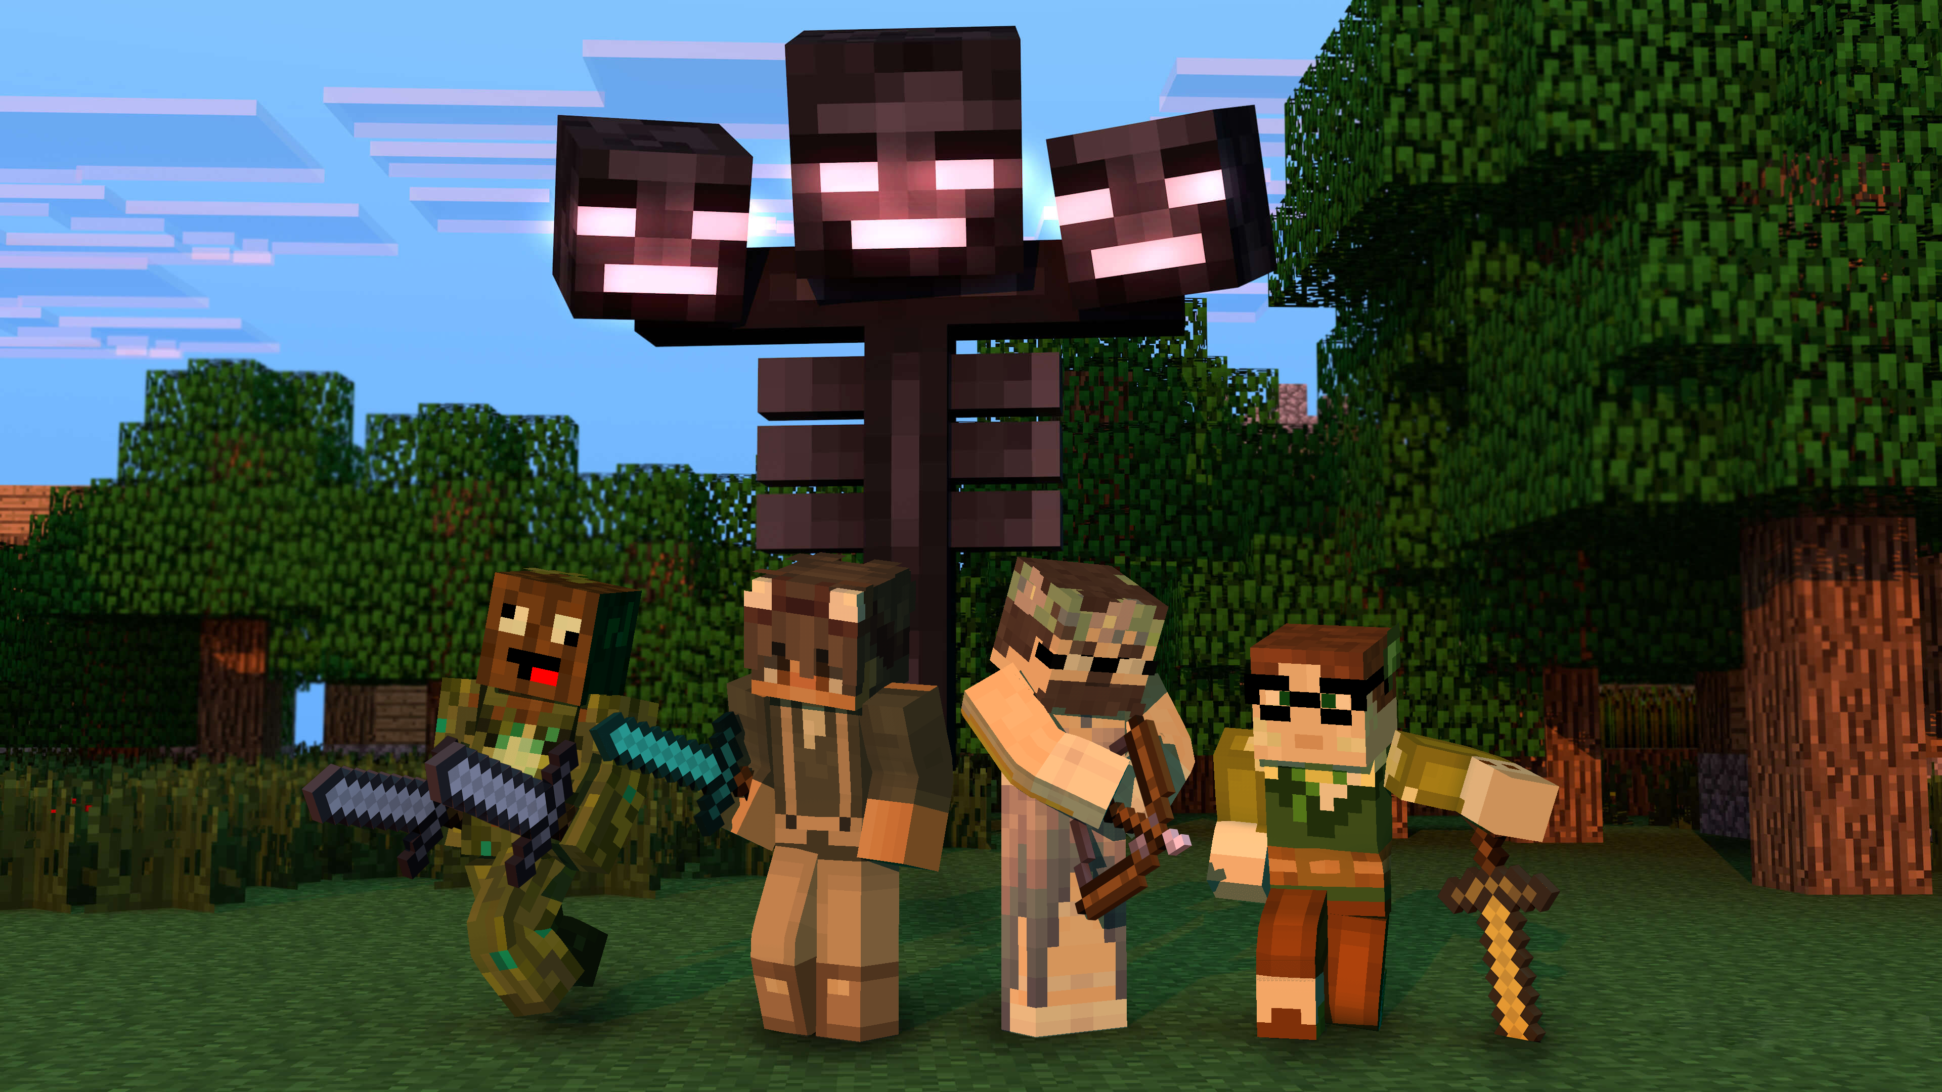


Slide 6
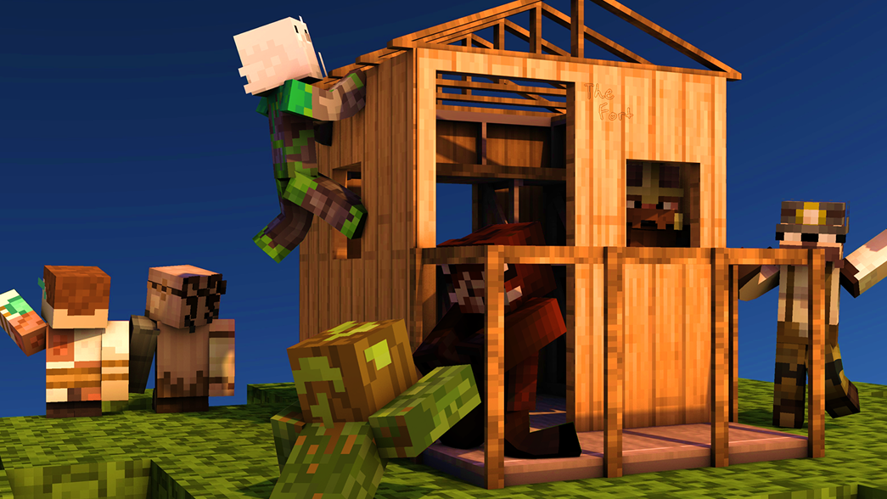


Slide 7


Slide 8



Slide 9
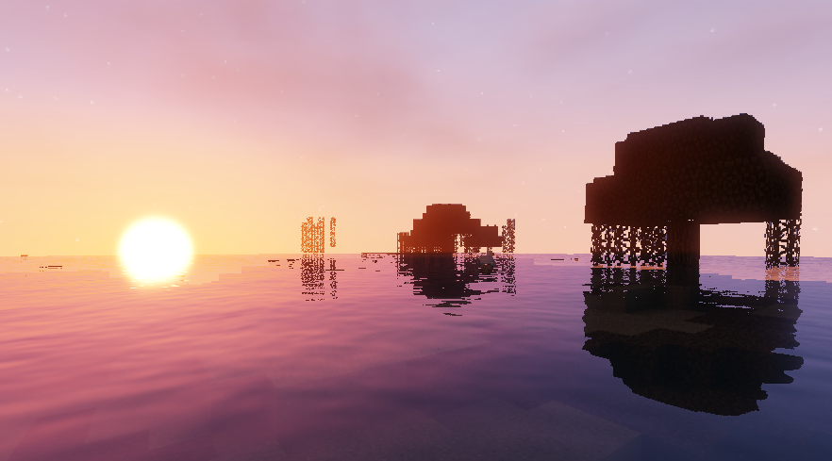


Slide 10
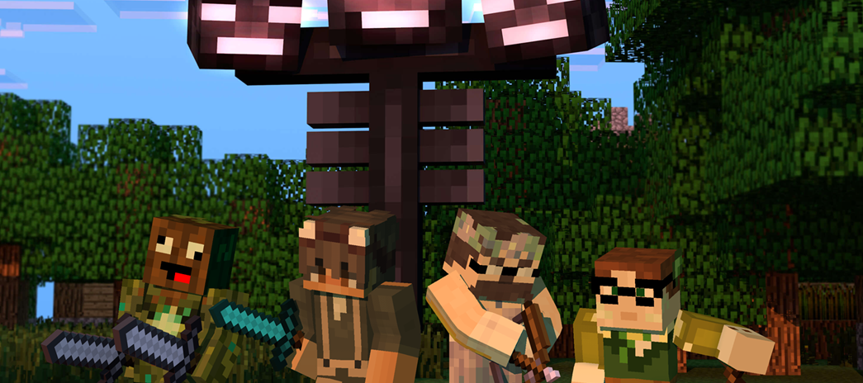
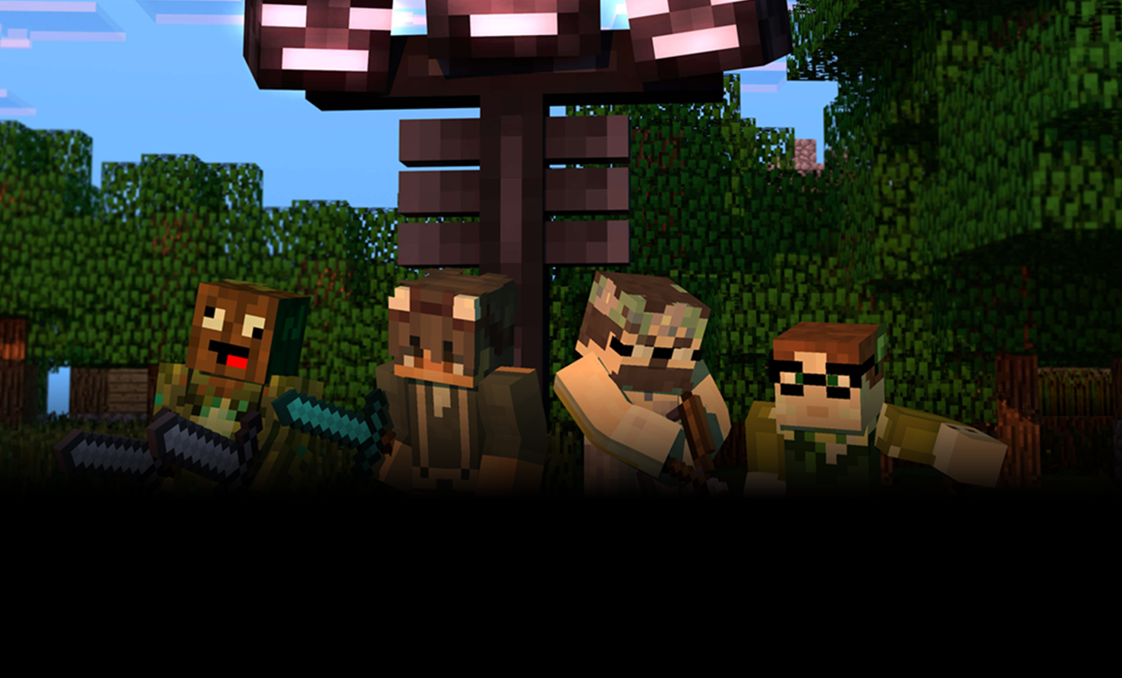

Slide 11
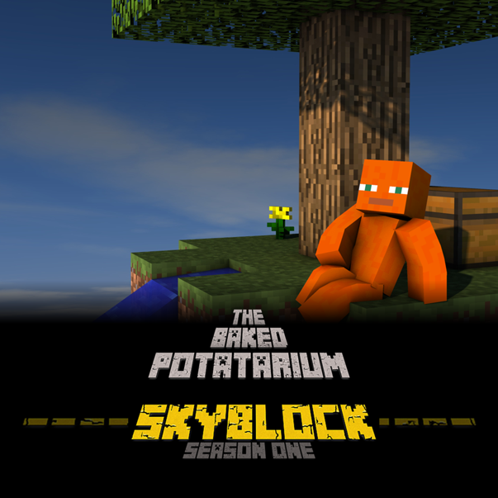


Slide 12






Slide 13
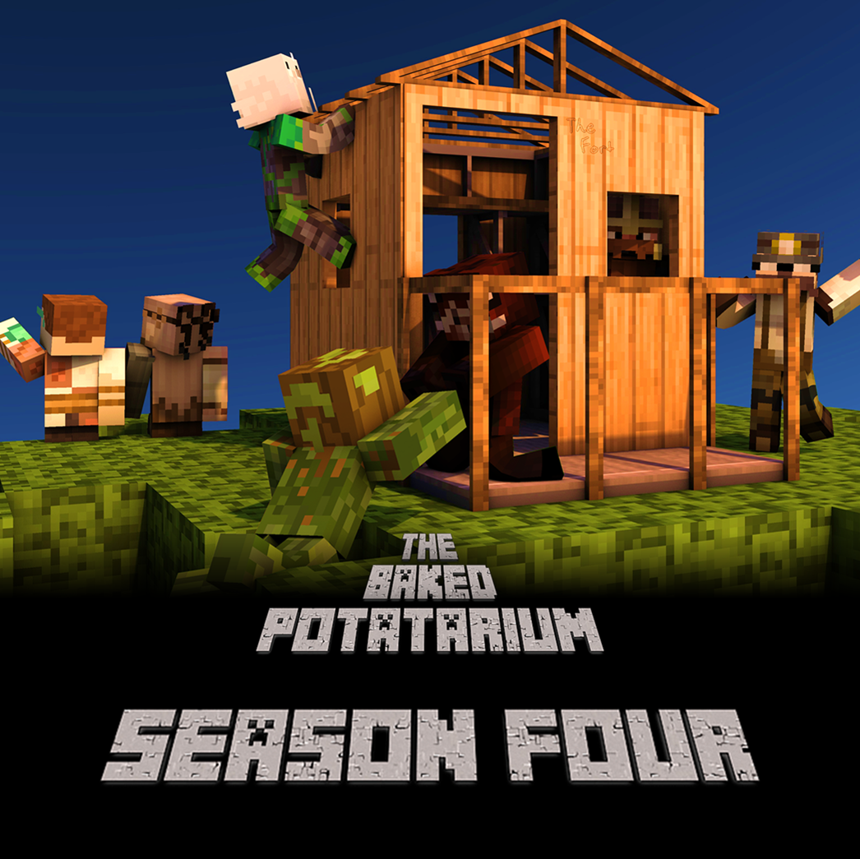
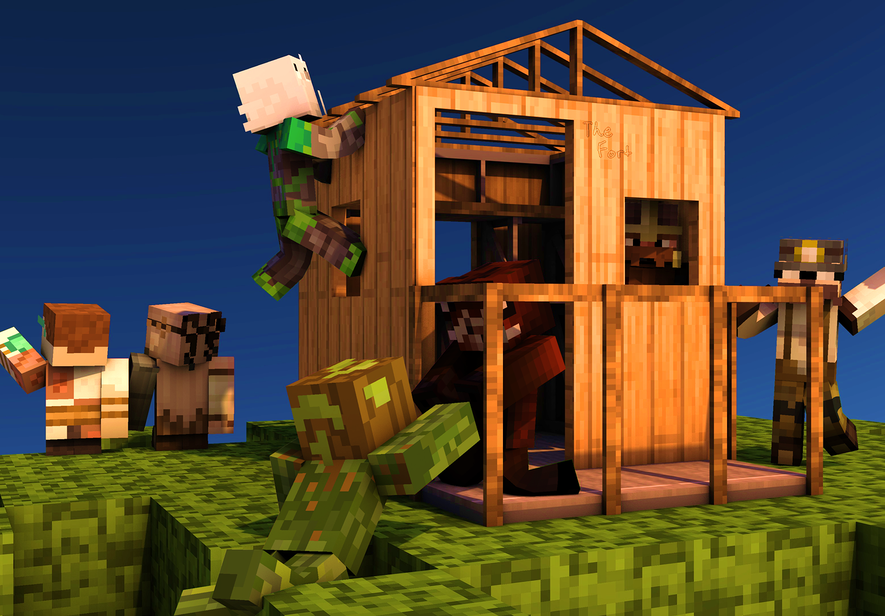


Slide 14
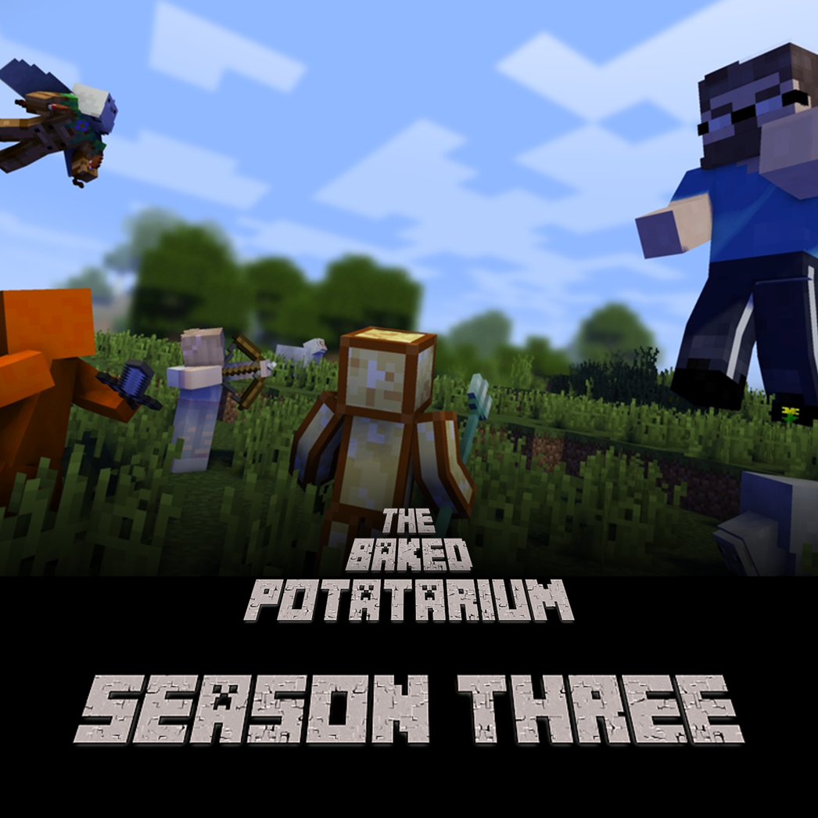
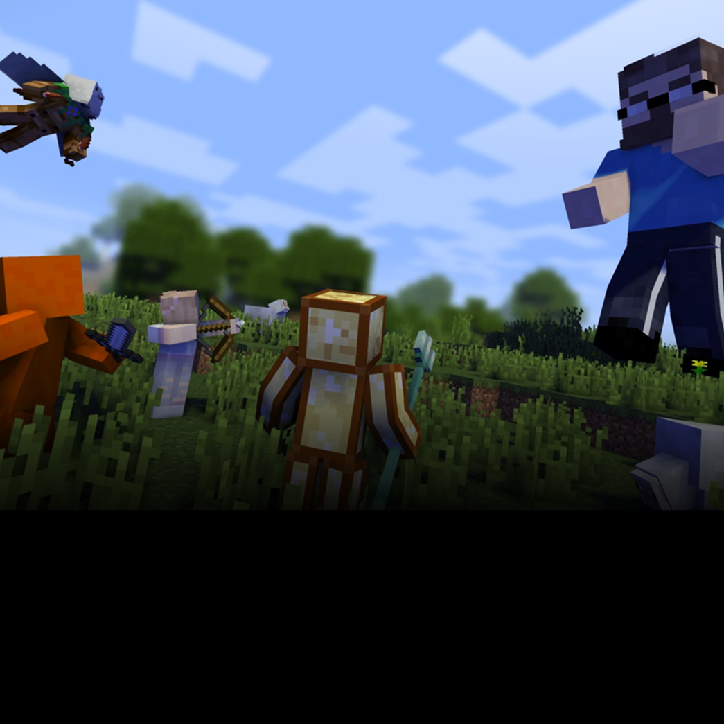


Slide 15




Slide 16

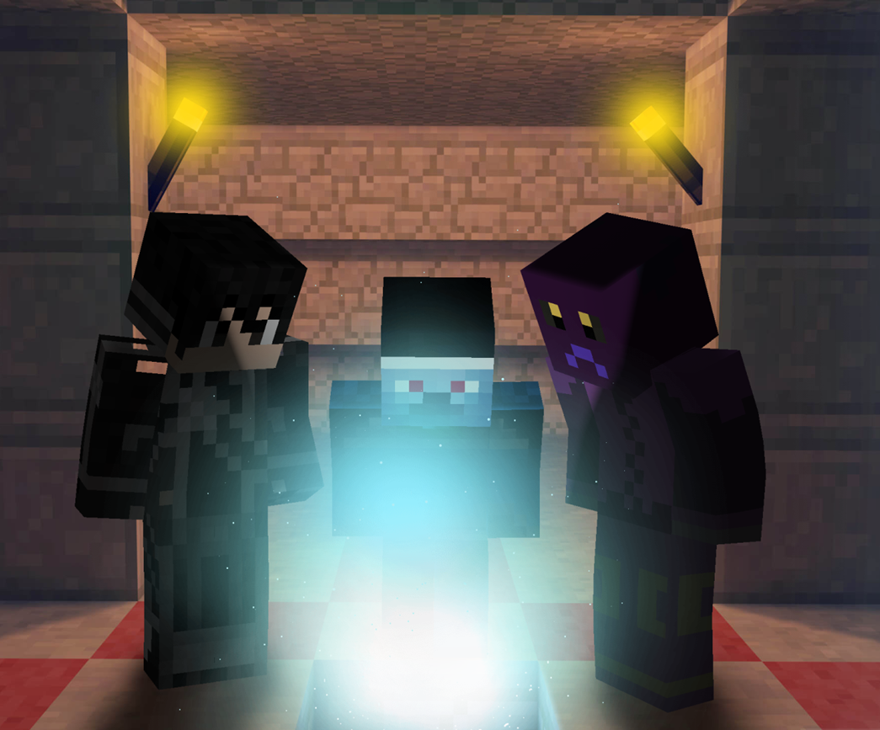

Slide 17
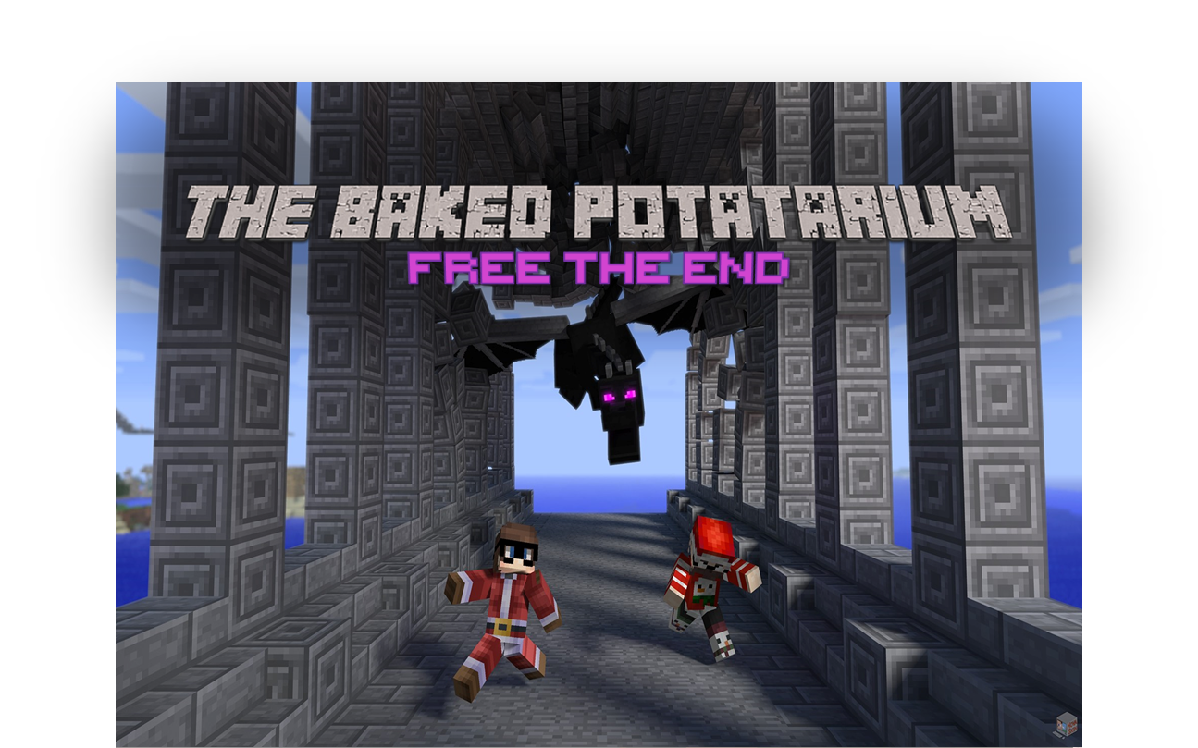
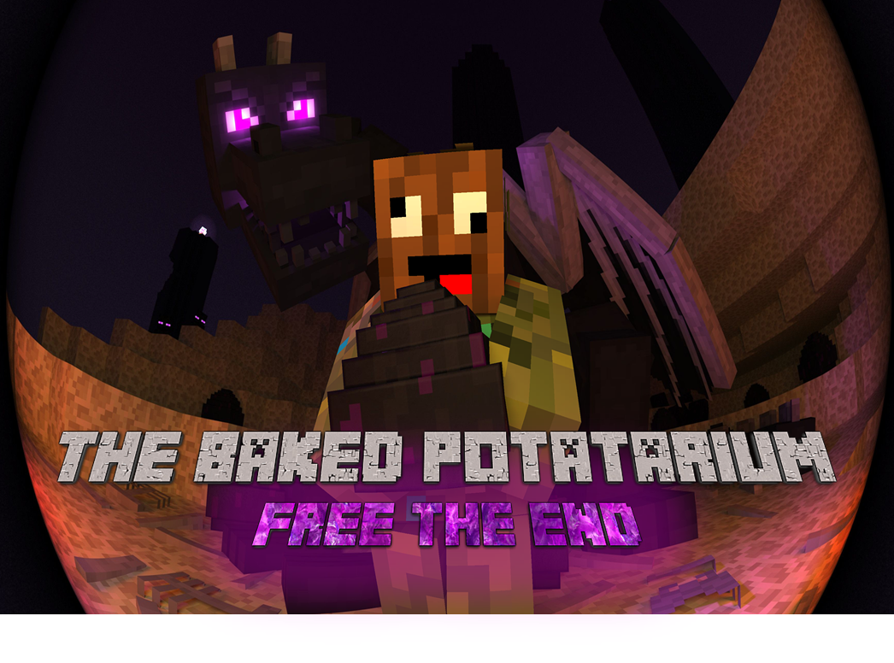
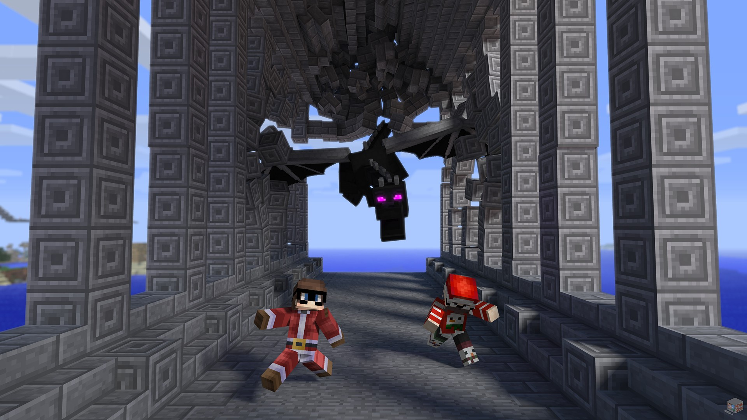
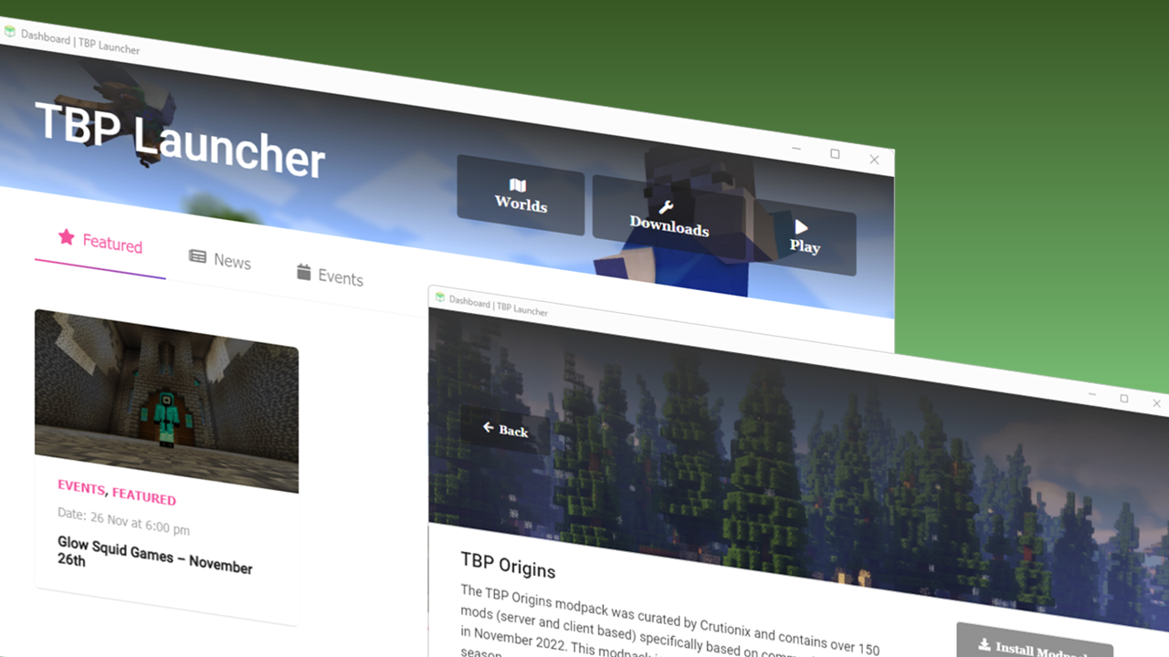
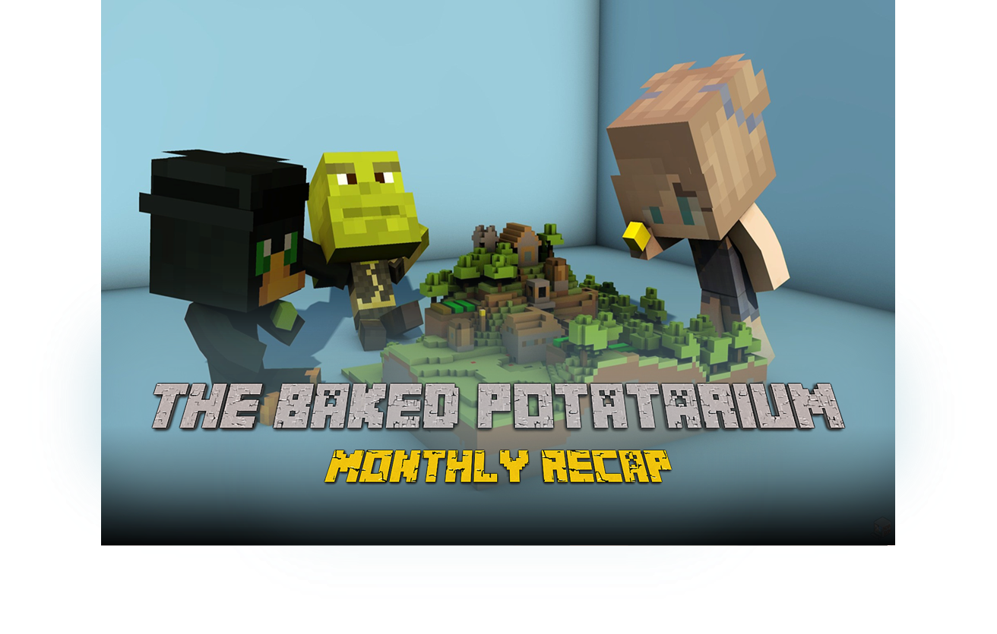
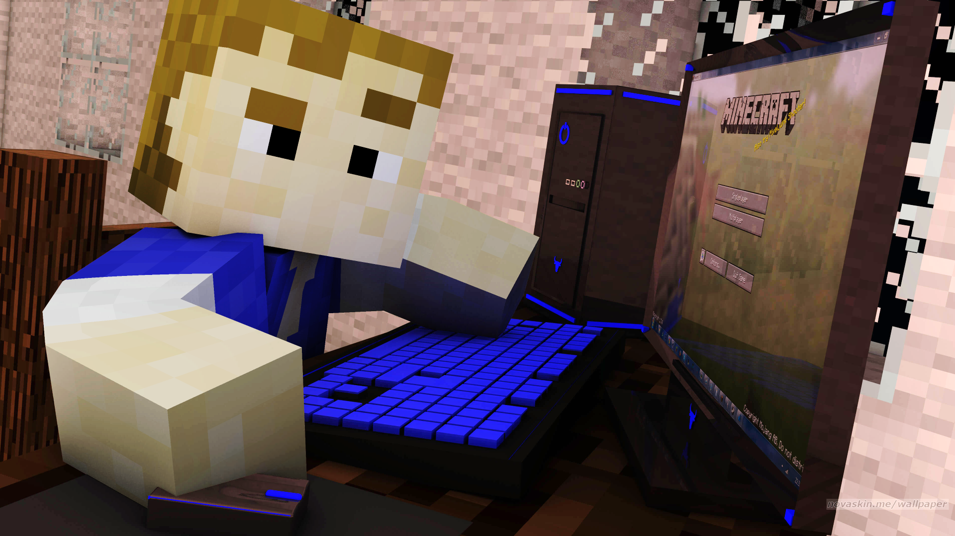

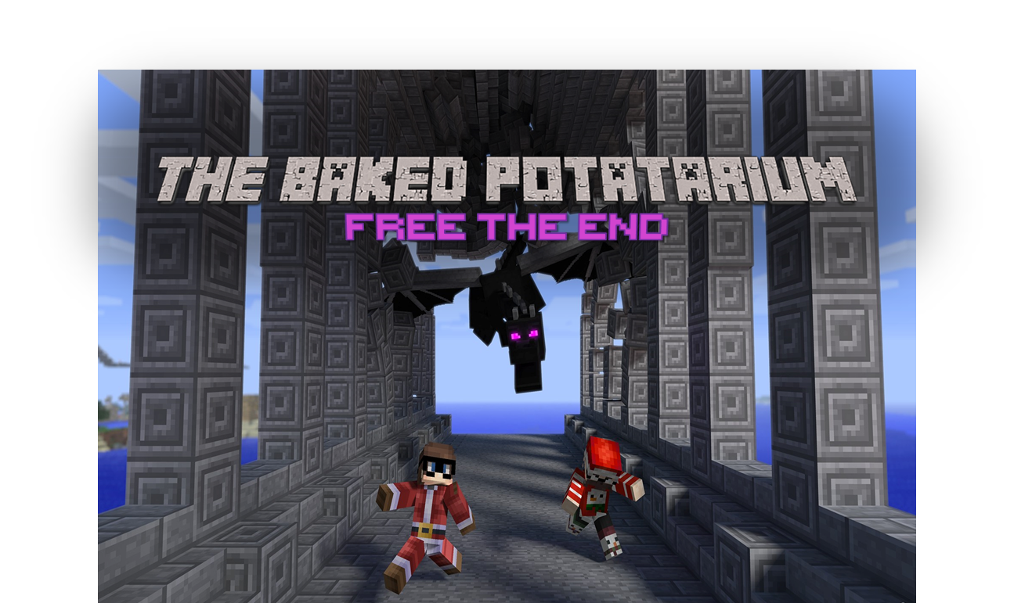
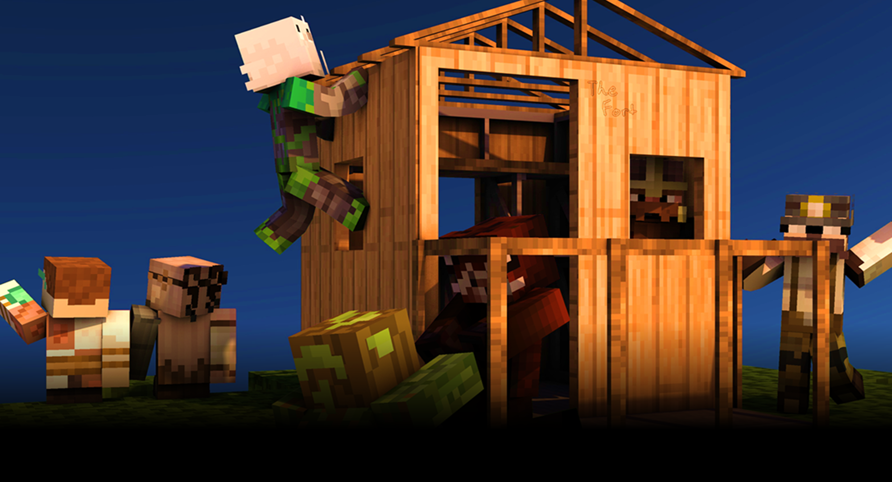
FREE THE END

Slide 18





Slide 19
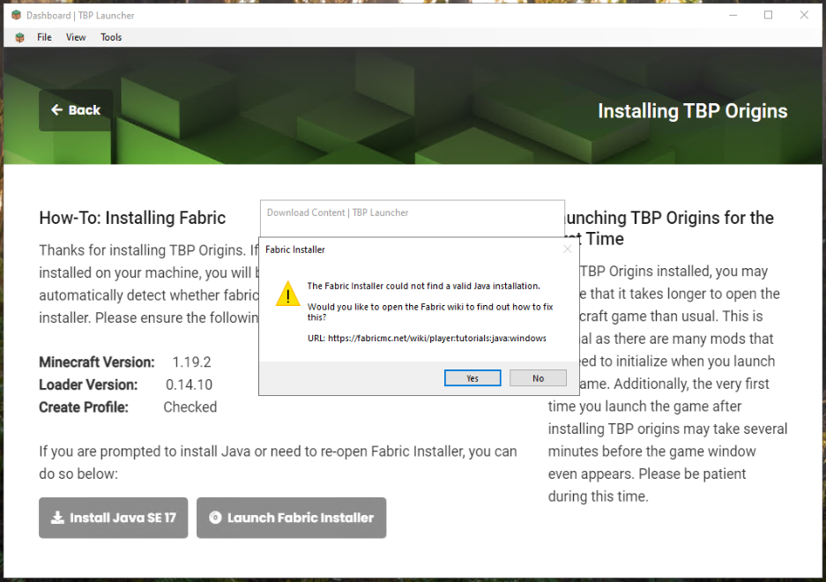
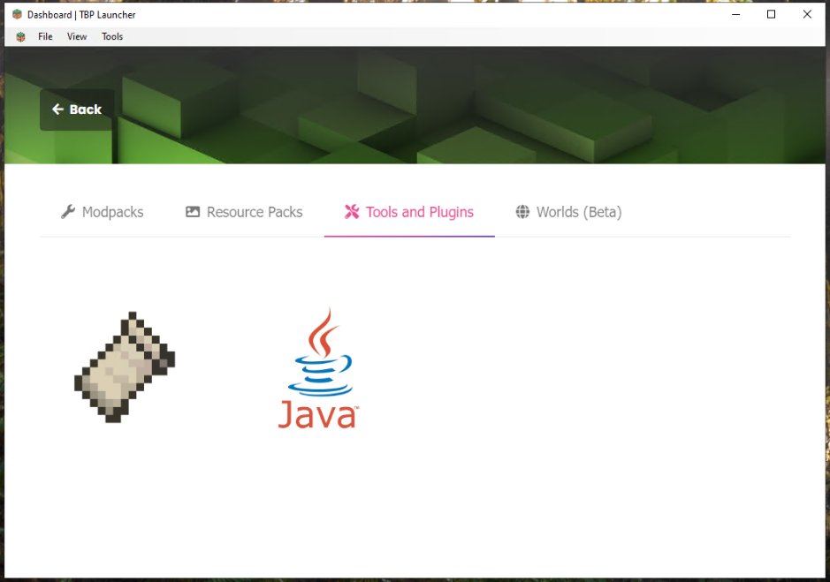
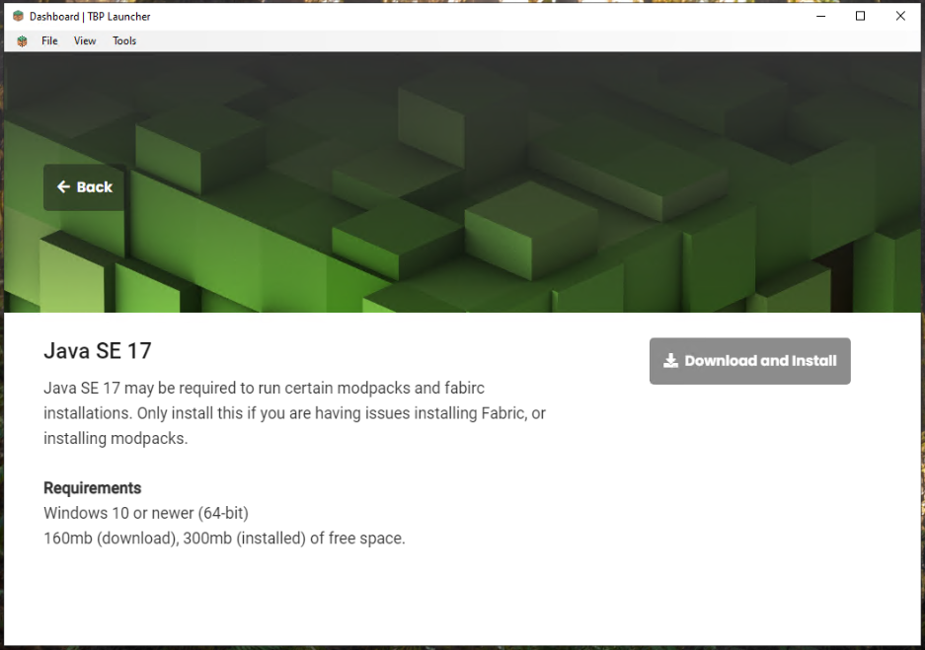
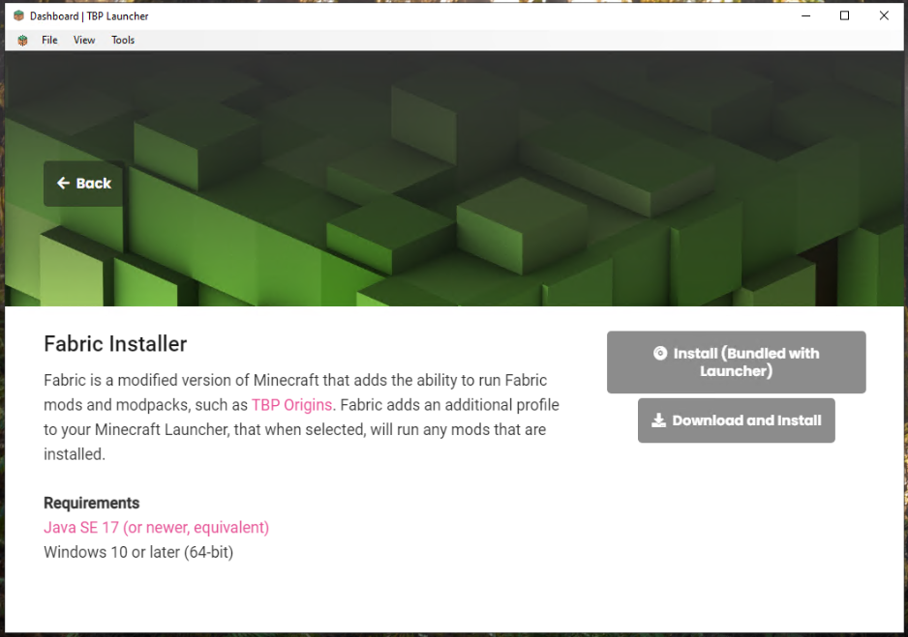

Slide 20

YOU’RE IN
YOU’RE IN
Thank you for registering your interest in TBP: Origins Season 1. We’re pleased to let you know that your whitelist registration has been accepted. Please make sure that you install the TBP Origins mudpack via the TBP Launcher or Crutionix.com. Instructions are available in the Discord. We’re looking forward to seeing you there!
Thank you for registering your interest in TBP: Origins Season 1. We’re pleased to let you know that since you voted yes on the feedback survey, you’re now registered to play. Please make sure that you install the TBP Origins mudpack via the TBP Launcher or Crutionix.com. Instructions are available in the Discord. We’re looking forward to seeing you there!

Slide 21
YOU’RE IN
YOU’RE IN
Thank you for registering your interest in TBP: Season 4. We’re pleased to let you know that since your whitelist application has been approved. Please read the available information in Discord and through the TBP Launcher or Crutionix.com.
We’re looking forward to seeing you there!
Thank you for registering your interest in TBP: Season 4. We’re pleased to let you know that since your account is in good standing, your whitelist application has been automatically approved. Please read the available information in Discord and through the TBP Launcher or Crutionix.com.
We’re looking forward to seeing you there!

Slide 22
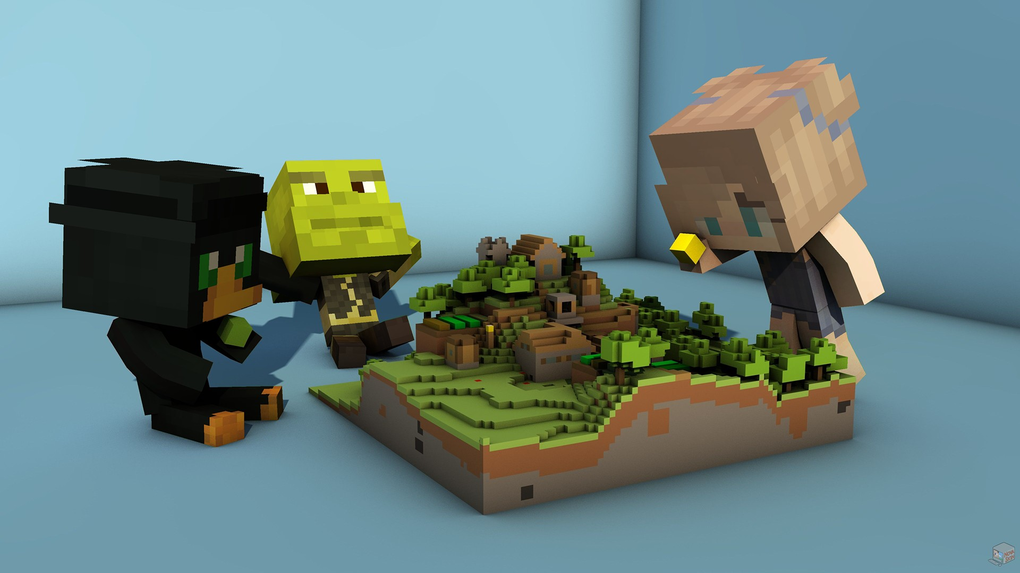

Slide 23
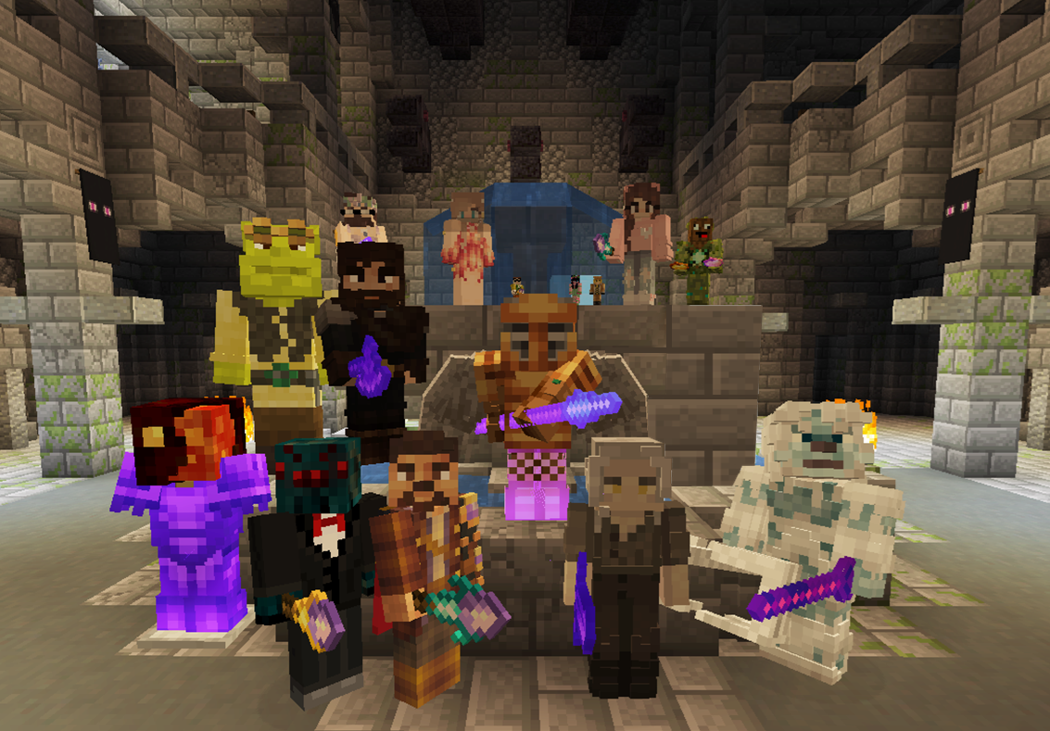


Slide 24
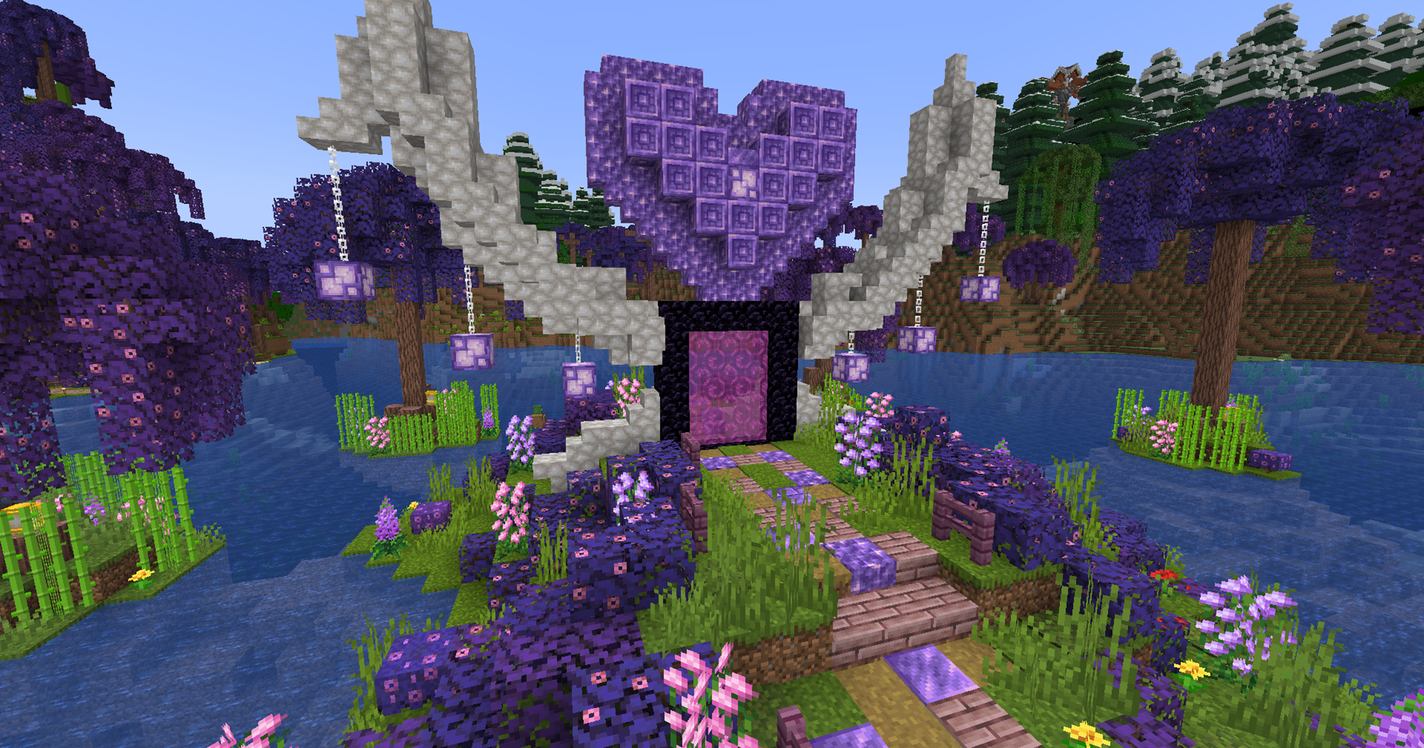
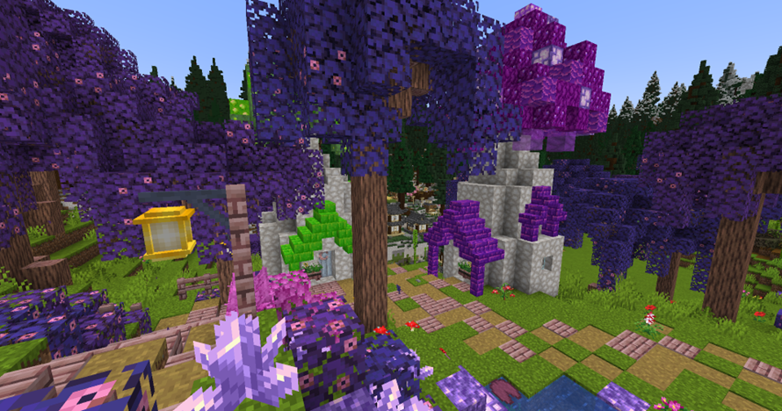
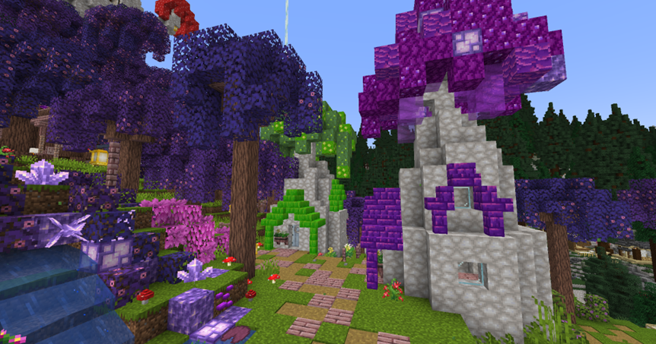
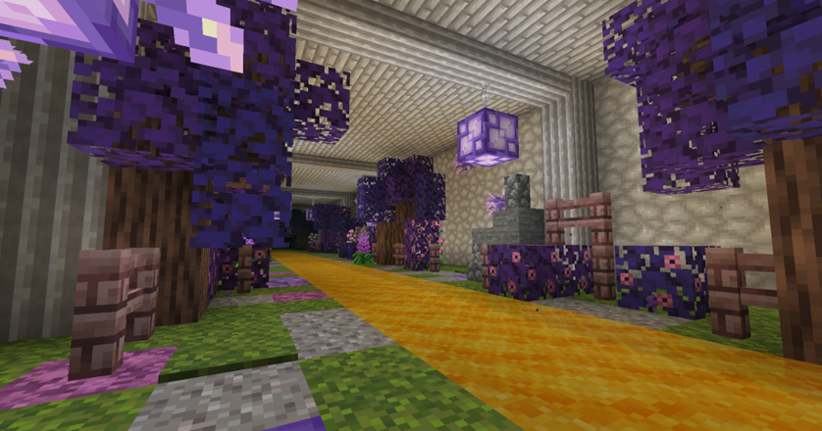

Slide 25

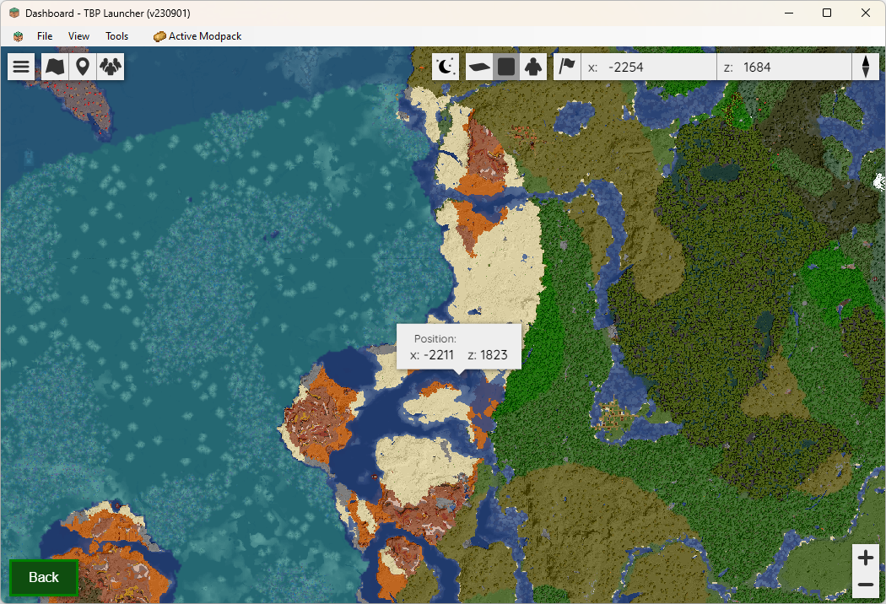
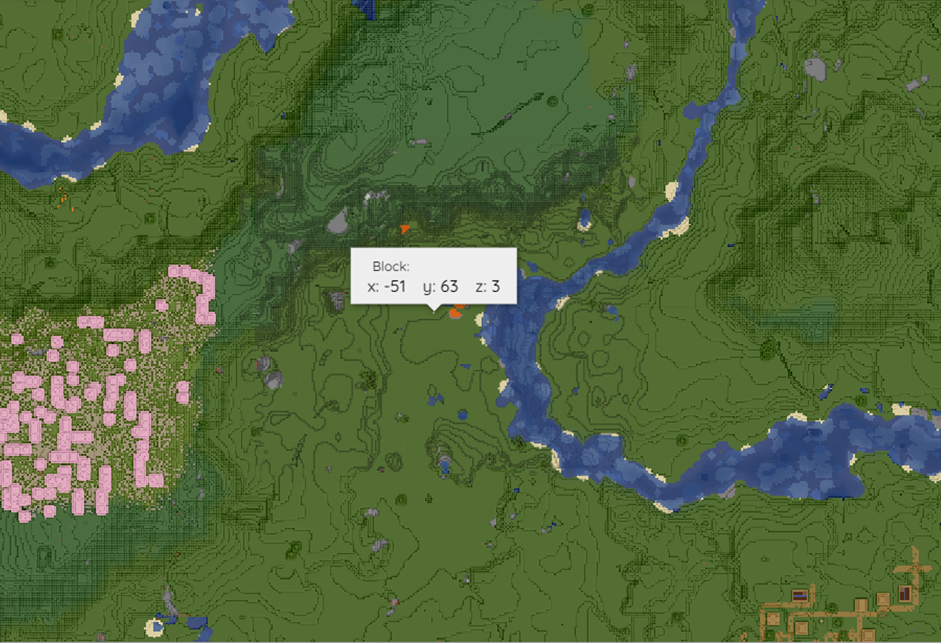
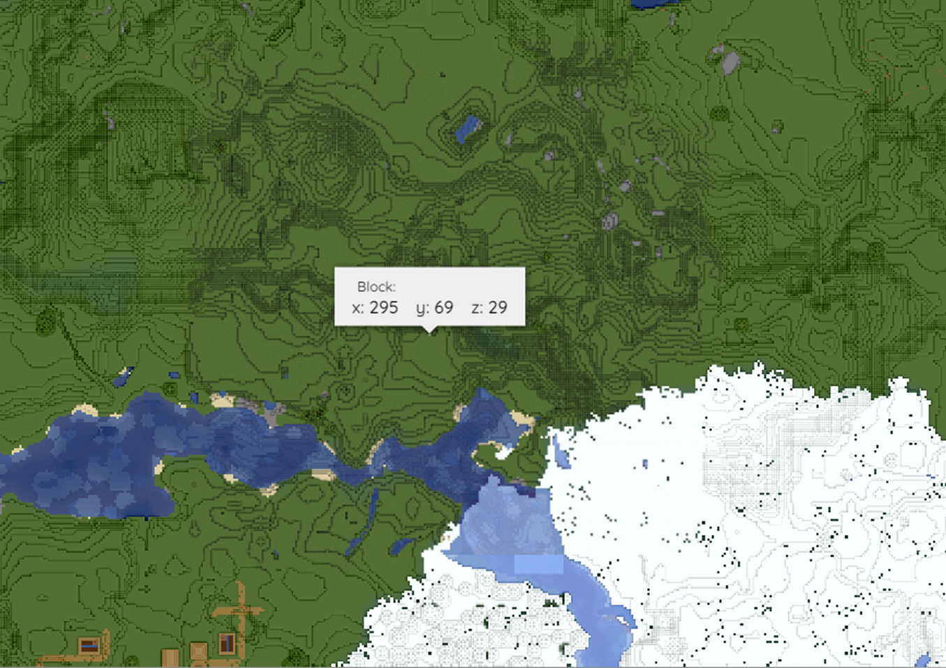

RESOURCE BIOMES
spawn
Cave dwellers
-2211 1823
-51 3
295 29

